Slide 1

Kubernetes 101

Slide 2
Kubernetes

Slide 3
What is Kubernetes?
Kubernetes is an orchestration tool for containers. It also provides scheduling and service discovery. Most of all it provides automation:
Automate the deployment and replication of containers
Automate scaling of the containers - scale in and out on the fly
Organize containers in groups and use labels to load balance them
Roll out new versions of apps and redirect traffic to new versions
Provide container resilience, meaning bring up new containers when a container malfunctions or dies immaturely

Slide 4
What is Kubernetes? (from Kubernetes)
Kubernetes is a portable, extensible, open-source platform for managing containerized workloads and services, that facilitates both declarative configuration and automation. It has a large, rapidly growing ecosystem. Kubernetes services, support, and tools are widely available.
The name Kubernetes originates from Greek, meaning helmsman or pilot. Google open-sourced the Kubernetes project in 2014. Kubernetes combines over 15 years of Google's experience running production workloads at scale with best-of-breed ideas and practices from the community.

Slide 5
Kubernetes Origin
2003-2004: Birth of the Borg System: Borg was the predecessor to Kubernetes, and the lessons learned from developing Borg over the years became the primary influence behind much of Kubernetes technology. Borg is a large-scale cluster administration system, which runs many thousands of jobs, from many thousands of different applications, across many clusters, each with up to tens of thousands of machines.
2013: Moving from Borg to Omega: Google announced the Omega cluster management system, a flexible, scalable scheduler for large compute clusters.
2014: Google Introduces Kubernetes as an open source version of Borg.
2015: Kubernetes v1.0 gets released. Google joined the Linux Foundation to form the Cloud Native Computing Foundation (CNCF).
2017: release of Kubernetes 1.6 as the first stabilization release.
2018: First Beta Version of Kubernetes 1.10 announced. And Kubernetes became available in DigitalOcean, Azure and AWS.

Slide 6
Kubernetes - When should you use it?
When to use Kubernetes?
If the application uses Microservices architecture, then go for Kubernetes by default.
If the team is looking to lower costs, then go for Kubernetes.
If the team is suffering from slow development and deployment cycles, then go for Kubernetes.
When not to use Kubernetes?
DO NOT USE KUBERNETES FOR A MONOLITHIC APPLICATION.
It will be difficult to appreciate the benefits of containerization and orchestration in such apps.

Slide 7
Kubernetes - For what should you use it?
Container orchestration
Kubernetes is Great for multi-cloud adoption
Faster time-to-market
Better management of applications

Slide 8
Kubernetes Container Orchestration
Containerize the applications
Integrate and Orchestrate the different components of the app
Scale up and Scale down the app on demand
Make the app and its instances fault tolerance
Provide communication across the cluster

Slide 9
Kubernetes Multi-Cloud Adoption
2 Stages of Multi-Cloud Adoption
Multi-cloud 1.0 — where the ability to distribute workloads across different clouds is the focus
Multi-cloud 2.0 — where the ability to transfer/recreate workloads across clouds is important.

Slide 10
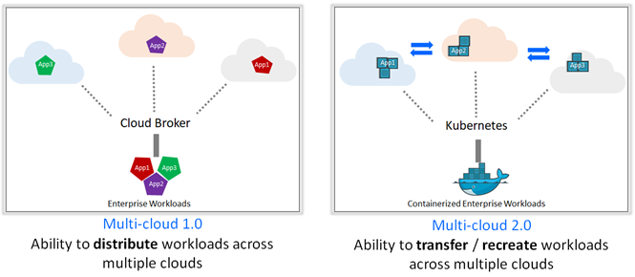
Kubernetes Mult-Cloud Adoption

Slide 11
Kubernetes - Multi-Cloud Adoption
With microservices gaining prominence containers and tools used to manage containers are also gaining prominence.
Kubernetes, is special because if works across all clouds with major vendors having an offering for Kubernetes.
Moreover, Kubernetes is open source and can easily be adopted to.

Slide 12
Kubernetes - Faster time-to-market
Containers, combined with an orchestration tool, provide management of machines and services for you, improving the reliability of your application while reducing the amount of time and resources spent on DevOps. Following features allow companies faster time to market their apps:
Horizontal infrastructure scaling - add or remove new servers
Auto-scaling - change the number of running containers, based on CPU utilization or other application-provided metrics
Health checks and self-healing - check the health of nodes and containers ensuring your application has not failed. You do not need to worry about if a container or pod fails.
Traffic routing and load balancing - comes with built-in load balancers that help to respond to outages or periods of high traffic
Automated rollouts and rollbacks - handles rollouts for new versions or updates without downtime while monitoring the containers’ health
Canary Deployments - Canary deployments enable you to test the new deployment in production in parallel with the previous version

Slide 13
Kubernetes - Better management of applications
Containers allow applications to be devised into small parts
Manage the smaller parts by orchestrating them
Use the above features to run different components of the app in sync
Overall better resource utilization, improves the cost efficiency
Overall better synchronization improves application performance and availability
Overall this leads to greater customer satisfaction and positive impact on ROI.

Slide 14
Kubernetes - Setting up - Windows
Install Chocolatey - https://chocolatey.org/
Open Powershell -
Install minikube - choco install minikube -y
minikube start – driver=hyperv
Install kubectl - https://kubernetes.io/docs/tasks/tools/install-kubectl-windows/#install-on-windows-using-chocolatey-or-scoop

